Slide 1

My web proposal
Zhipeng Sun

Slide 2

The Sportscar Home
A comprehensive gallery of the contemporary sportscars.
An informative database for the specs of each car.
Compare and contrast the track lap times and general performances of each car.

Slide 3
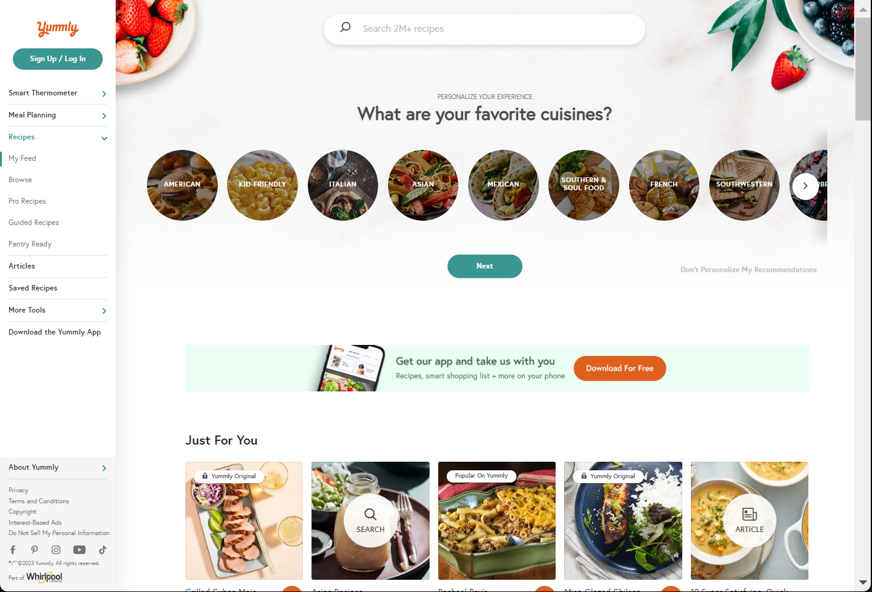
Existing Website - Yummly

Slide 4
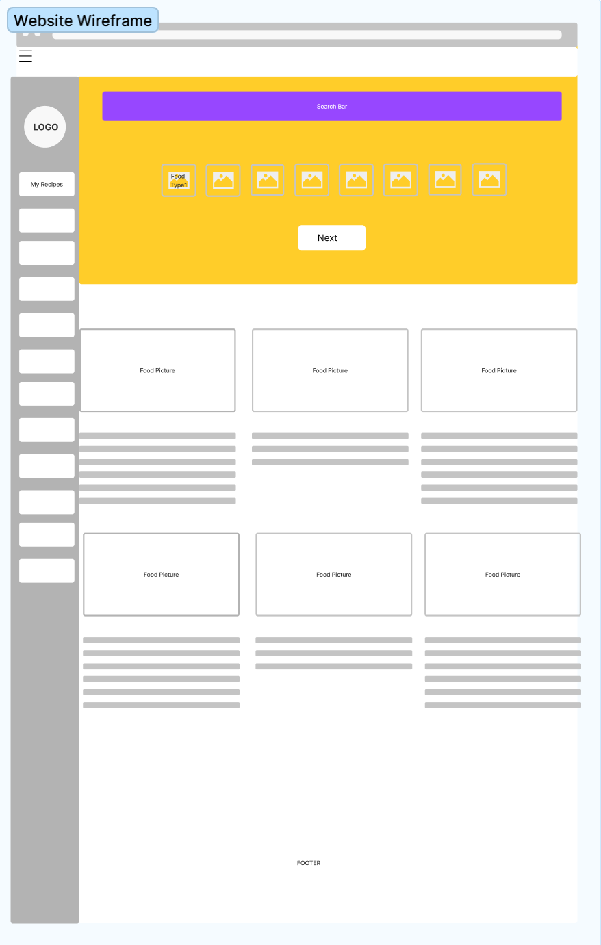

Slide 5
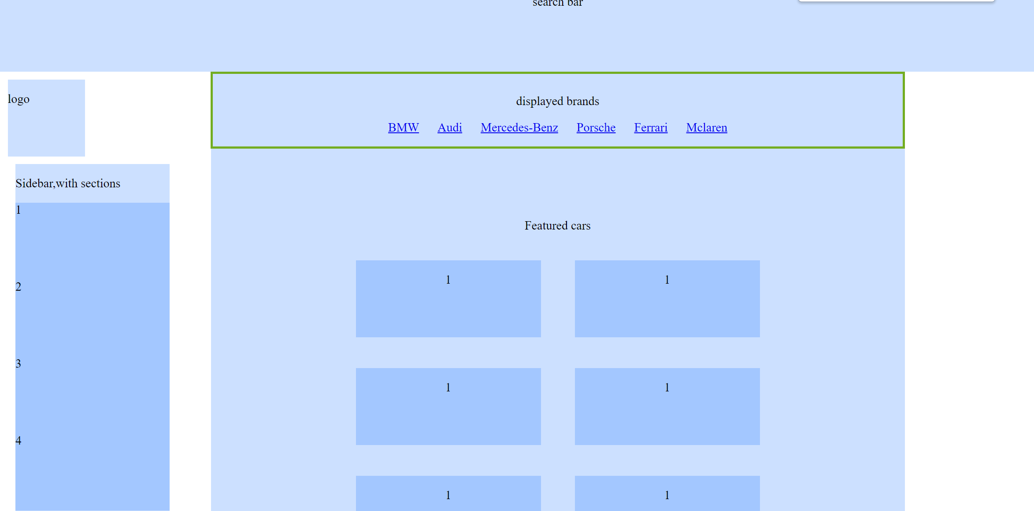

Slide 6
SKILLS REQUIRED
THE BASIC STYLING AND POSITIONING OF DIVS AND ARTICLES
THE NAV BAR (INCLUDING BASIC ANIMATION SKILLS)
THE SEARCH BAR
HTML DESIGNING TECHNIQUES ( HOW TO MAKE THE WEBSITE MORE COLORFUL AND BEAUTIFUL)

